Slide 1
A Rigorous Framework for Trial Design via Simulation
BBSW November 2021
Michael Sklar
Stein Postdoctoral Fellow, Stanford
https://mikesklar.github.io/thesis/
Notes:
The technical material in this talk will be based on Chapter 5 of my PhD thesis. You can find a copy of it at this github link – https://mikesklar.github.io/thesis/
You might need to try refreshing the page it a few times to get your download, since it’s a large document If you are watching this talk as a recording in the future, I may also decide to put a landing page there with further comments and follow-ups _______ Talk: __
About three years ago, I was a second year graduate student at Stanford, I went up to Tze Lai and said wanted to work with him on clinical trials. And he said, “good, we will do adaptive enrichment.”

Slide 2
The Innovation Process for New Designs?
Statistician
New Design
Pharma Runs Trial
Clinician
Notes:
At the time, this is how I thought it would happen: As a statistician, I would talk with clinicians and conceive a new design. If it’s any good, pharma will decide to run it; and then at that point it’s out in the wild, people can go ahead and copy it. The next three years of my PhD was a slow process of coming to grips with the fact that this is not how the process works. Innovation is in fact very hard.

Slide 3
The Innovation Process
New Design
Journal Submission
Pharma Runs Trial
Notes:
The first thing you should probably do is submit your design to a journal. OK, not too hard – it takes time, but you will get published eventually

Slide 4
The Innovation Process
New Design
Journal Submission
Persuade Pharma Decisionmakers
Pharma Runs Trial
Notes:
Then you have to persuade pharma to use it

Slide 5
The Innovation Process
New Design
Journal Submission
High Reward &
Low Execution Risk
Persuade Pharma Decisionmakers
Pharma Runs Trial
Notes:
So, you’ll have to make the case that it gives you benefits that are worth the operating risks and the costs of complexity. Which are, admittedly much larger than you’d expect. If you can do that, that’s enough for your early phase trial! And hey, if you look around, I think we actually are in a renaissance of adaptive design for early phase

Slide 6
The Innovation Process
High Reward/
Low Execution Risk
Persuade Pharma Decisionmakers
Low Risk of Slow Processing or Denial
New Design
Journal Submission
Pharma Runs Trial
Notes:
But if you’re in late phase, you’ll need to convince the company that it’s not going to affect their FDA processing.

Slide 7
The Innovation Process
High Reward/
Low Execution Risk
Persuade Pharma Decisionmakers
Low Risk of Slow Processing or Denial
New Design
Journal Submission
Pharma Runs Trial
Persuade FDA Decisionmakers
Notes:
In practice, this means the FDA has to be persuaded about wanting to use a new design

Slide 8
The Innovation Process
High Reward/
Low Execution Risk
Persuade Pharma Decisionmakers
Low Risk of Slow Processing or Denial
New Design
Journal Submission
Pharma Runs Trial
Pass FDA validation and negotiations
Persuade FDA Decisionmakers
Type I Error Proof
Notes:
To persuade the FDA, you might need to pass through negotiations - and supply evidence that you’re controlling Type I Error

Slide 9
The Innovation Process
High Reward/
Low Execution Risk
Persuade Pharma Decisionmakers
Low Risk of Slow Processing or Denial
New Design
Journal Submission
Pharma Runs Trial
Pass FDA validation and negotiations
Persuade FDA Decisionmakers
Type I Error Proof
Notes:
First, there’s the concerning possibility negotiations will change the design, sending you back to square 1, and have to do this over again. So you’d better have very flexible methods.

Slide 10
The Innovation Process
High Reward/
Low Execution Risk
Persuade Pharma Decisionmakers
Low Risk of Slow Processing or Denial
New Design
Journal Submission
Pharma Runs Trial
Pass FDA validation and negotiations
Persuade FDA Decisionmakers
Type I Error Proof
Notes:
But the more challenging issue: You might notice that we now have a circular dependency here, because in order to get into FDA negotiations over a very niche design, you need to have a sponsored application. So this is a chicken-and-egg loop – you can’t persuade the FDA until you’ve persuaded pharma and vice versa. This is probably stopping a good deal of innovation. Fortunately, at least to my eyes as an outside observer – noting that I could well be the least informed person on this topic in this video call - it looks like FDA leadership is making great strides in remedying this

Slide 11

Simulation shortens the innovation pipeline
High Reward/
Low Execution Risk
Persuade Pharma Decisionmakers
Low Risk of Slow Processing or Denial
New Design
Journal Submission
Pharma Runs Trial
Pass FDA validation and negotiations
Persuade FDA
Decisionmakers
Type I Error Proof
Notes:
With programs like the complex innovative design program. The key tool here is simulation – you get to slice out the math for a Type I Error proof, and the need for journal validation. And so you can hopefully iterate much more quickly. And this is a wonderful thing! But, as a part of the trade-off, we get new questions and areas for negotiation which need to be settled in this key part of the innovation loop [Next slide: John Scott’s questions from 2018.]

Slide 12
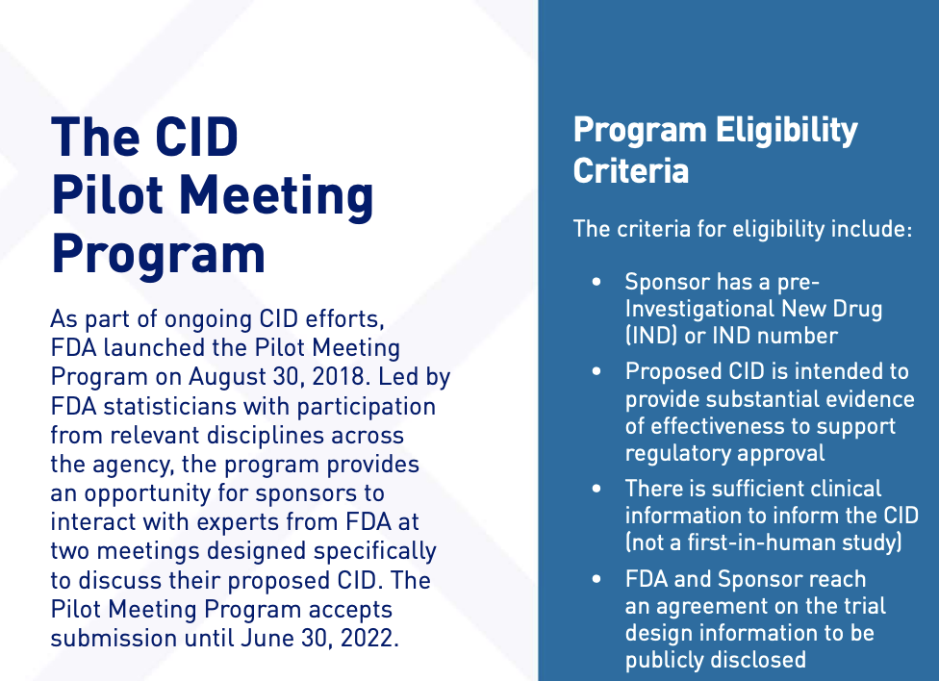

Slide 13
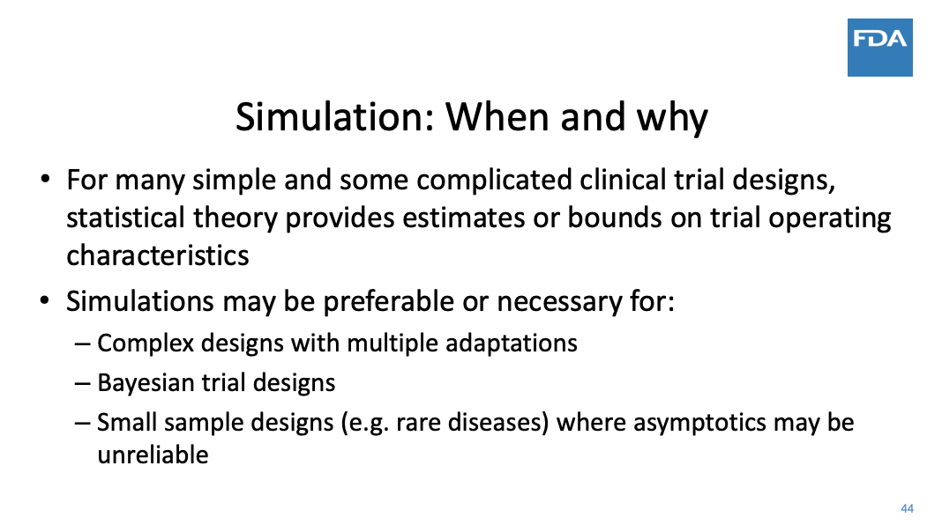
(Lifted from FDA website – John Scott, 2018)

Slide 14
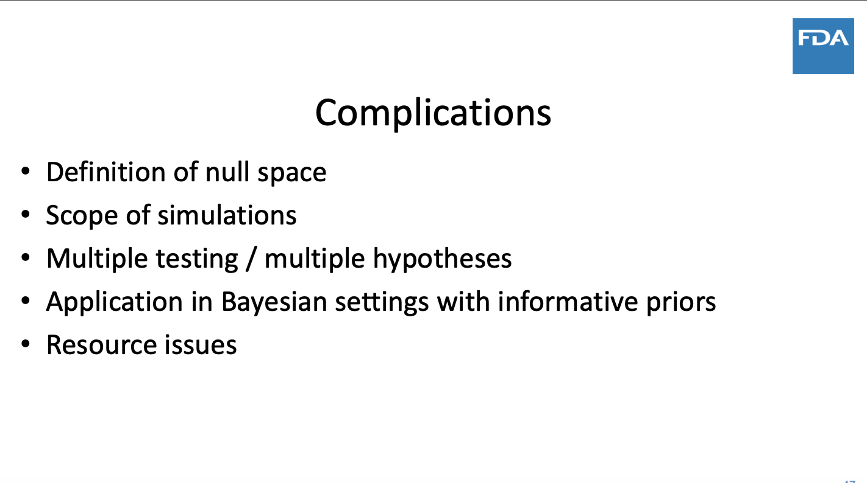
Notes:
These slides are stolen off of the FDA website from a 2018 presentation by John Scott.
I don’t know what the John Scott of today would say, but the John Scott of three years ago would say these are the key challenges: - you have to define a null hypothesis space, and some kind of model - you’ll simulate the design at many points in that null hypothesis space – but how many?
- Do you have enough computational power to do it all, with multiple hypothesis testing? In order to handle it all, will you have to become a Bayesian?

Slide 15
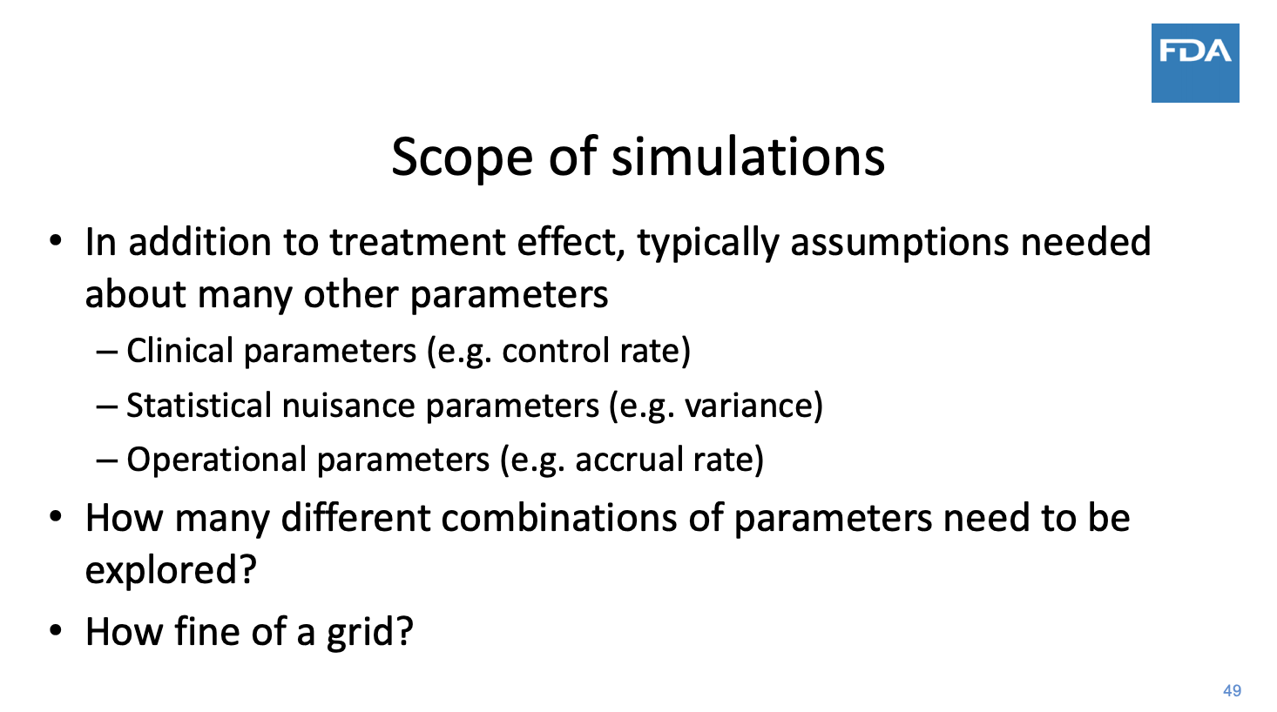
Notes:
And zooming in on the scope of simulations – we have some difficult questions here! I don’t know know how CID is approaching this. Even in single cases, I imagine this can be very challenging.

Slide 16
Notes:
The technical work we’re going to discuss today is really a tool for attacking this question, but taken to an extreme.

Slide 17
A Rigorous Framework for Type I Error Control in Complex Trial Design
Idea: Get provable and tight control of Type I error by filling in the gaps between simulation grid-points
In progress: software to validate new designs with this technique
Increase the scope of what is allowed
Reduce burden on regulators
Increase predictability for designers
Gave a version of this talk for the FDA, as a webinar on September 8th
Notes:
We’ll try to build it out in hopes of re-instating the Type I Error proof - this time using simulations instead of math.
My question for you all is: how can we most effectively use this tool to make validation and innovation faster?

Slide 18
Roadmap for the Talk:
How to bound Type I Error over continuous space with simulation
Examples
Features
Tuning critical values for tight & non-asymptotic proof
Re-design and Platform trials
Takeaways and Future Directions
Questions
[Math slides available upon request]
Notes:
That is about as far as I want to go on high-level introduction. In the rest of the talk, We are going to go through the key ideas in this type I Error proof – delaying the actual math as long as possible, I want to that to be the very last thing. I’ll show some examples, talk about what’s hard, then what else you can do, and finally talk about how we can actually make this happen with software that you trust, because until then, it isn’t real. Any questions on the context before we start? The floor is open…

Slide 19
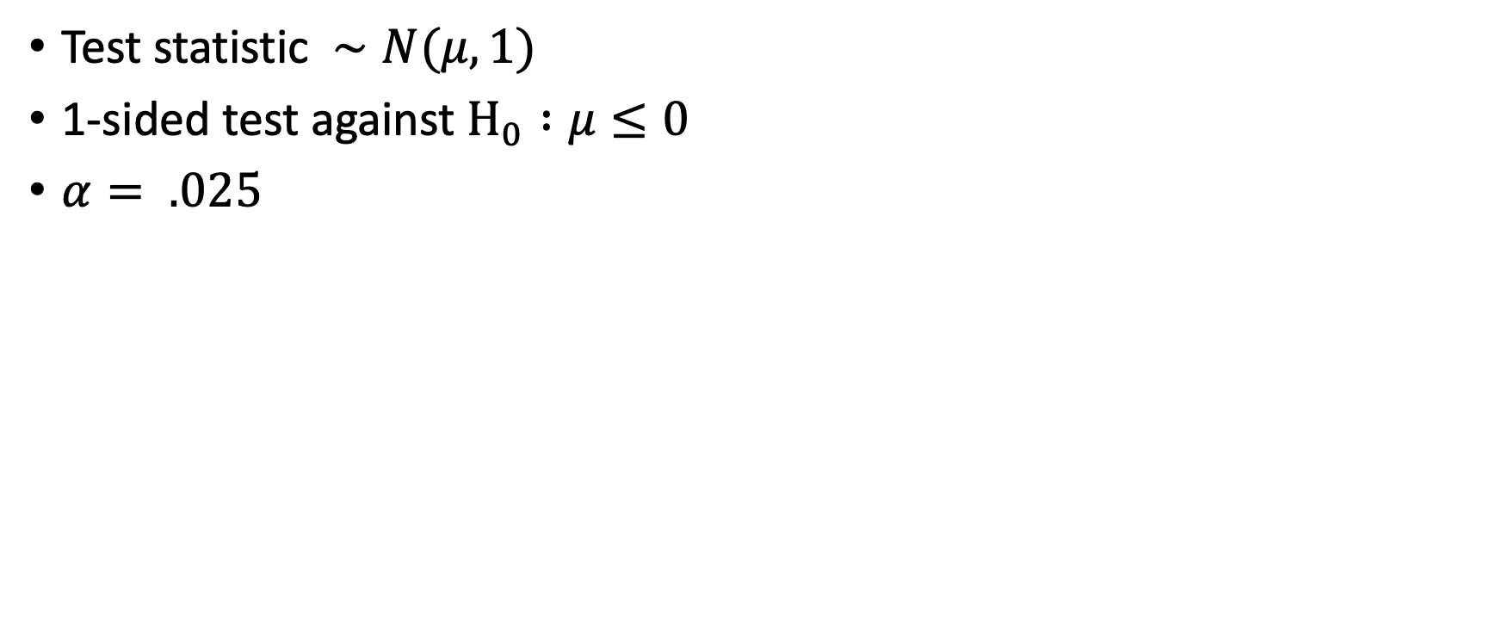
Consider the most basic test
Test statistic $∼N(μ,1)$
1-sided test against $H_{0} :μ≤0$
$α= .025$

Slide 20
Consider the most basic test
Test statistic $∼N(μ,1)$
1-sided test against $H_{0} :μ≤0$
$α= .025$

Slide 21
Zoom in on Type I Error near the Ho boundary

Slide 22
Assume we know the exact Type I Error only at a few points…
Notes:
As if you had infinitely many Monte Carlo simulations – So these points are on the line from the last slide. Our problem is now: Can we reconstruct the dotted line to show that our design controls Type I Error?
This is a problem, because if this is all we know, the Type I Error could be wiggly.

Slide 23
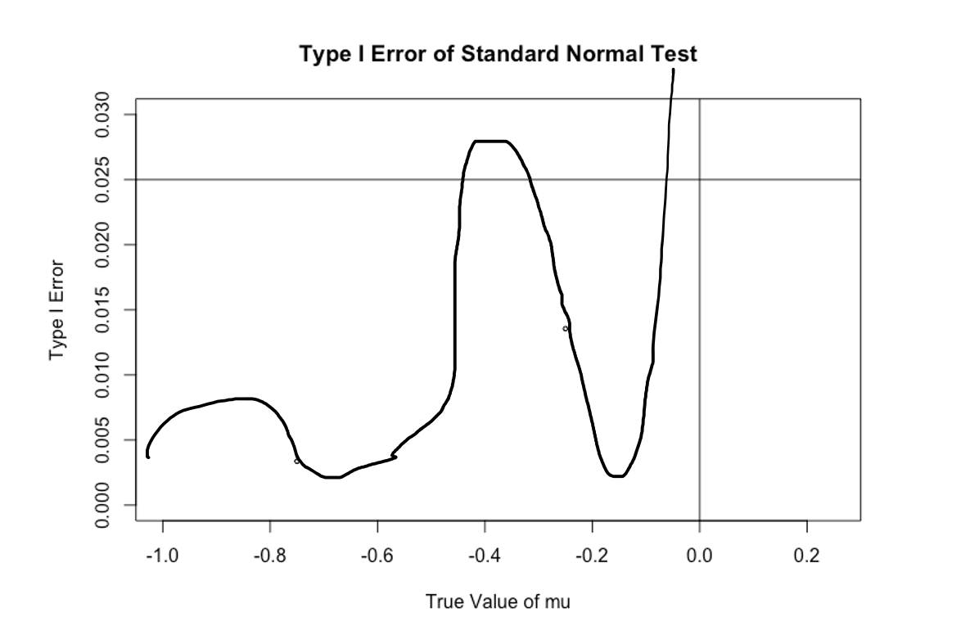
Assume we know the exact Type I Error only at a few points…
Notes:
As if you had infinitely many Monte Carlo simulations – So these points are on the line from the last slide. Our problem is now: Can we reconstruct the dotted line to show that our design controls Type I Error?
This is a problem, because for all we know, the Type I Error could be wiggly.

Slide 24
Assume we know the true derivative of Type I Error at those points too
Notes:
If you ALSO knew the derivative of the type I Error, Then you could try to make a linear approximation to the Type I Error function.
But there is some bad news…

Slide 25
First-order approximation is close but not conservative
Notes:
In this case, we are consistently below the true type I Error function. So this is not an upper bound, and not a proof technique.

Slide 26
Taylor’s Theorem Describes the Error
Notes:
Draw a parabola connecting a point on the graph with the base point, to show what quad approximation does! ALSO = I believe the conservative approximation is unnecessarily 2x conservative than usual!!

Slide 27
But using a worst-case bound on the second derivative, we get a conservative approximation
Notes:
But it turns out we can get back conservativeness using a bound on the second derivative. This is a consequence of Taylor’s theorem, where we are using an inequality on the second-derivative term. You’ll notice that this particular bound might be pretty bad! We’re off the top of the chart here, we were hoping to bound the Type I Error below 2.5% and we got that it’s below 5% or 10%. That’s not wrong, but it’s not tight. But let’s double the simulation size

Slide 28
Double the number of simulation points

Slide 29
Double the number of simulation points

Slide 30
Double the number of simulation points

Slide 31
Double the number of simulation points
Notes:
And this is now very convincing . So within an order of magnitude of computation, we went from it being almost uselessly loose, to being as tight as you could ever really care. There are two issues here to point out: (1) First, this is a one-dimensional case. If you were in two dimensions, you might need two orders of magnitude more computation to get the same amount of improvement. It’s not obvious that this will scales well. (2) Second, we cheated! We assumed we had exact knowledge of the true Type I Error function, and the derivative of the Type I Error function. In practice, we don’t have that.

Slide 32
Monte Carlo simulations leaves uncertainty
Notes:
In practice, what we can do is make confidence intervals for these. So here, there is the usual Monte Carlo interval going vertically. And then the shaded part is a confidence interval you could make for the derivative. In practice, what we’re going to do is make those confidence intervals, and consider the worst bound that we could get from them.

Slide 33
Monte Carlo simulations leaves uncertainty
Notes:
Combining those, we get regions that look like this for the first order approximation. And then to this, all we have to do add is the quadratic penalty, and we’ll have a generic upper bound.

Slide 34
Key Steps:
Find a general upper bound to the second derivative
Construct confidence intervals with the Monte Carlo simulation for the point estimate of Type I Error and the derivative
Give each interval a confidence of 1 - 𝛿 / 2
Maximize our Taylor expansion upper bound over these confidence intervals
Result: A (pointwise) 1 - 𝛿 upper confidence bound to the true Type I Error function
Notes:
So this tells us how to build our framework: In each area where the Type I Error function is smooth: [list out these steps] Note that a pointwise bound is exactly what we want. Because whatever the drug’s effectiveness is, it won’t change in response to the simulation’s randomness.
OK – we will return to go over the math behind this slightly more thoroughly at the very end of the talk. Are there any questions so far?

Slide 35
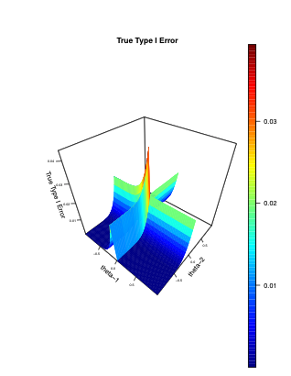
Example: FWER for Two Arms
What if you did two independent z-tests?
Here is a display of the true FWER, as a function of the parameters

Slide 36
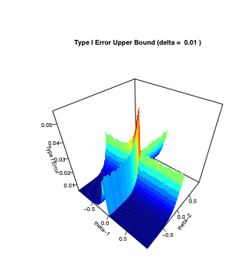
Our 99% confidence upper bound

Slide 37
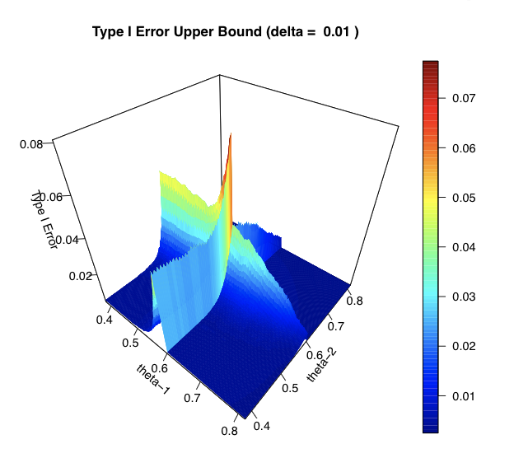
Adaptive Trial Example: Thompson Sampling
Two arms
Bernoulli (𝛉i) outcomes
Ho : 𝛉i < .6
N = 100
Beta(1,1) prior
Reject arm i at the end if posterior P(𝛉 i > .6) > 70%
With a cluster: ~800,000 Monte Carlo samples per point
~16,000 grid points
Notes:
-1.5 – 3 orders order magnitude by running on a GPU -floating point operations. [lots more capacity!] -[Can I write things in terms of array operations?] -Cuda , nvidia’s GPU programming language. [Hardest]; most flexible. It’s basically a variant of C. -Write operations abstractly; the tool compiles down to GPU operations -GPU: 1 hour: $2 ; 10-20c for an older GPU. And it turns out this method really flexible. We can use it for highly adaptive trials. This one is about as adaptive of a trial as it gets. We’re doing something like a Bayesian Phase II in oncology – using Thompson sampling, aka posterior sampling.
We have two arms with binomial outcomes, with a Bayesian rejection at the end You can see why this is hard to handle analytically with math, because it has a kink. So you are usually forced into simulating like this to figure out the operating characteristics; now we have proof as well. That’s not to say this is easy with these methods either; here we’re doing 800,000 samples per point; and we’re looking at 16,000 grid points here. That’s 10 billion simulations, and I had to use Stanford resources.

Slide 38
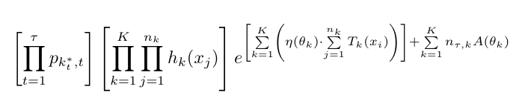
Setting: Data is Exponential Family
Includes your favorite R.V.’s : Gaussian, Binomial, Exponential, Gamma, Weibull, …
Adaptive Data Collection is OK!
Censored Data is OK!
Applies to Gaussian Processes, Brownian Motion
Hence, for the limiting distribution of max-likelihood estimates with i.i.d data
Or, Cox regression under a proportional hazards assumption
Notes:
From the point of view of simulation – if you have the actual outcome in your computer censored data is just a restriction on what the rejection rule is allowed to use; And thus, using a censored likelihood is like a de-randomization. It makes things better, not worse.

Slide 39
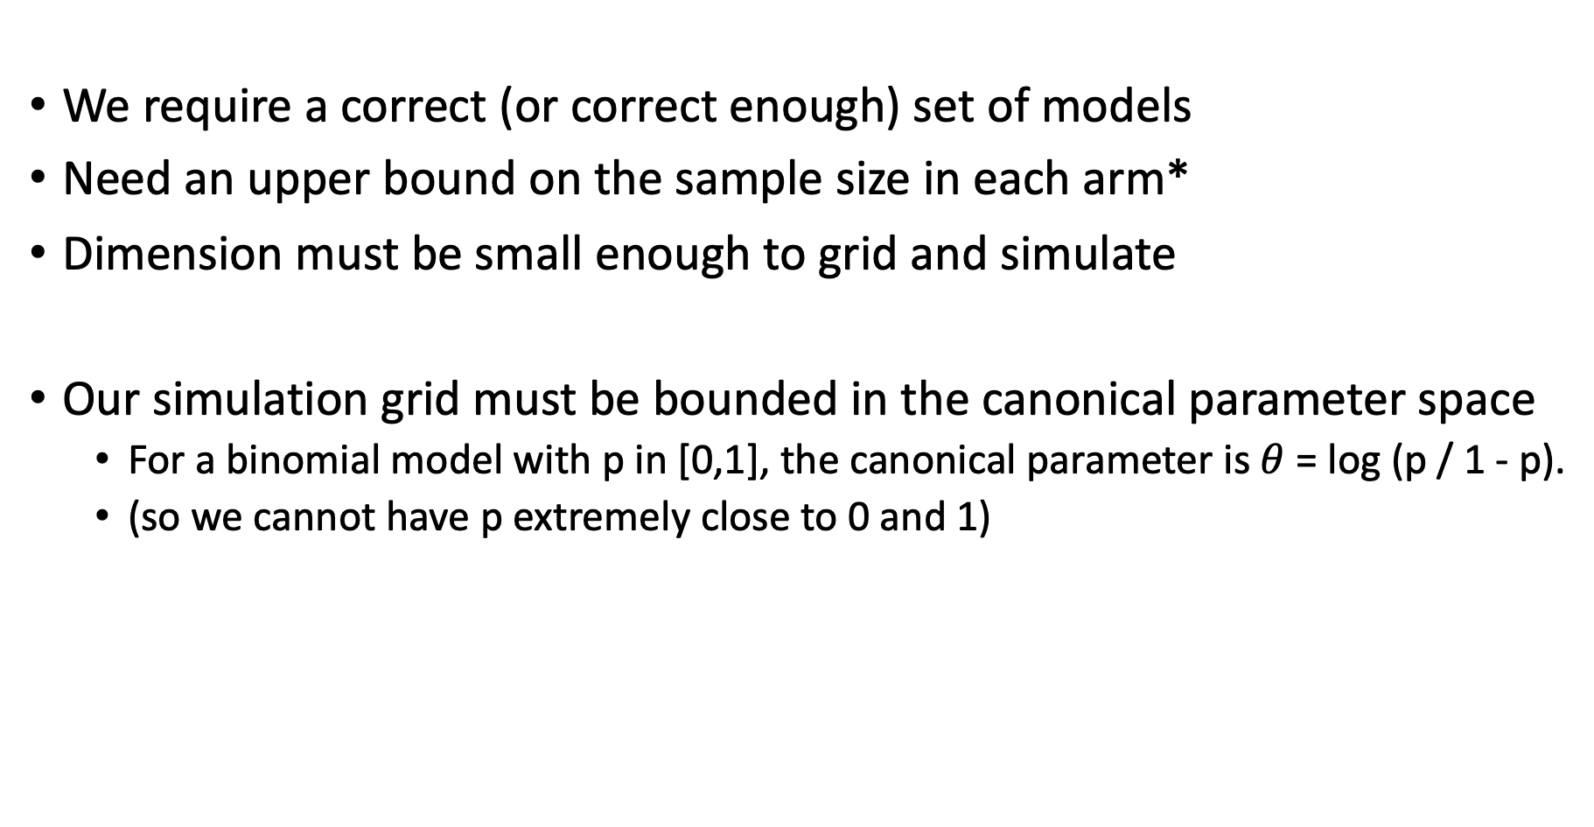
Assumptions
We require a correct (or correct enough) set of models
Need an upper bound on the sample size in each arm*
Dimension must be small enough to grid and simulate
Our simulation grid must be bounded in the canonical parameter space
For a binomial model with p in [0,1], the canonical parameter is $θ$ = log (p / 1 - p).
(so we cannot have p extremely close to 0 and 1)
Notes:
Technically, I think this sample size restriction can be lifted, although I do require it in my thesis. I think it can be replaced with a guess of a moral upper bound to the sample size to control the curvature.

Slide 40
Challenges
Massive computational power
[Example uses 10^10 simulations for 2 unknown parameters]
Difficulty quickly increases with complexity and # of parameters
Regulatory agreement on the model class for simulations
Well-behaved model for the data (exponential family)
Includes Gaussian, binomial, exponential, gamma, some Weibull models
(Censoring and adaptive sampling are OK)
Justification for focusing on a compact part of null hypothesis space
Notes:
Of course, we are not going to knock out the entire class of complex designs. -For lots of designs, it’s just not going to work. -Now, computers are always getting more powerful, so there is a long-term interest here. I don’t know whether this will max out at a 3-arm trial, and only go up another arm per year.
_____ [List other issues] ____ Note that two issues here – 2 and 4, are more general problems with simulations, that I imagine the CID team is facing in its current cases ____ Narrowing in on the model is a challenging issue! It’s something I’m sure CID is finding ways to deal with in their current work, and I really look forward to seeing cases and standards for what is acceptable. Similar for justifying why we can limit our attention to a bounded region. Which can involve a math proof, or constraints of reality.

Slide 41
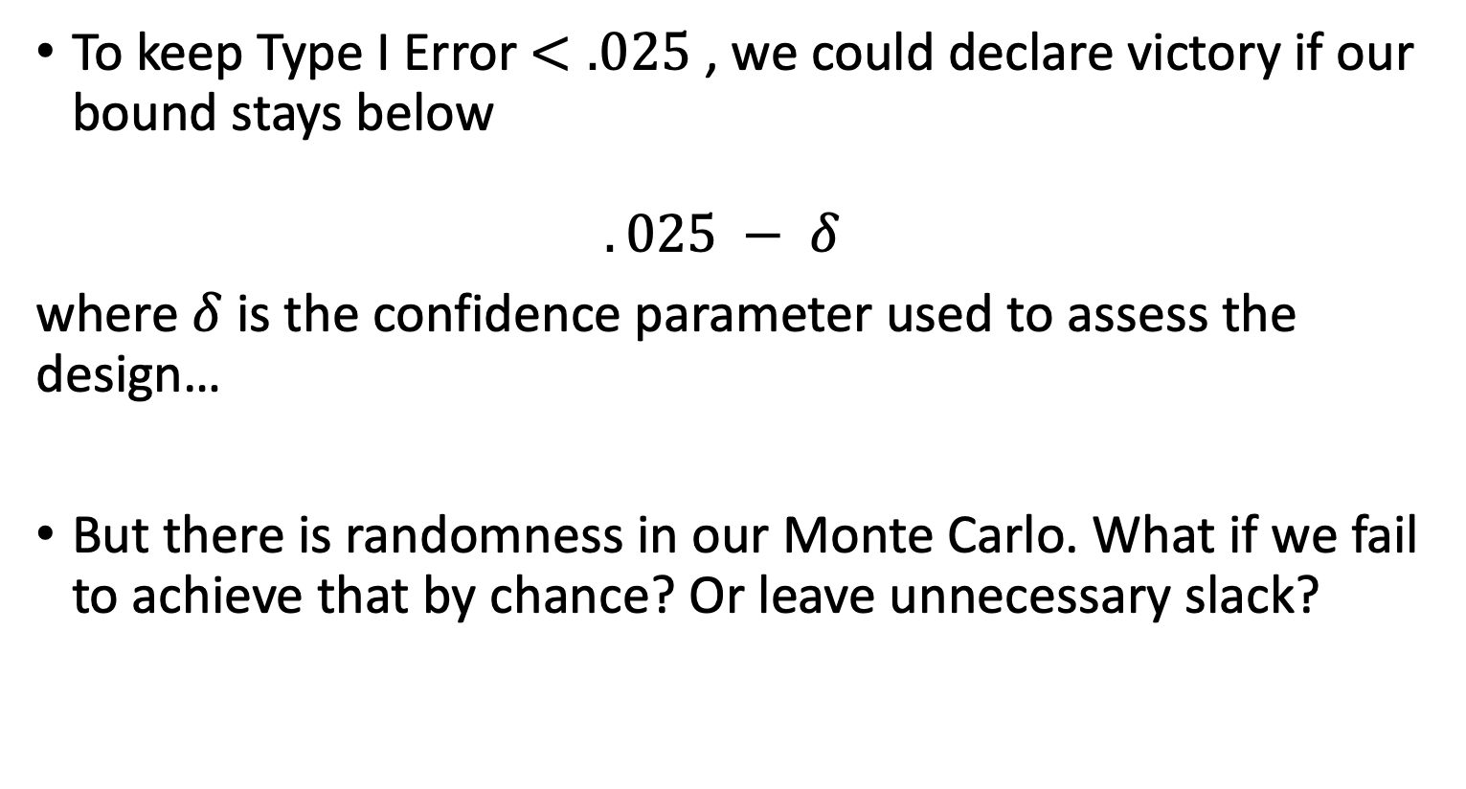
A possible workflow issue?
To keep Type I Error $<.025$ , we could declare victory if our bound stays below $.025 − δ$
where $δ$ is the confidence parameter used to assess the design…
But there is randomness in our Monte Carlo. What if we fail to achieve that by chance? Or leave unnecessary slack?
Notes:
“Just run it again” does not inspire confidence.
But there is a better way…

Slide 42
Solution:
Tune the rejection threshold while we perform the validation to guarantee an overall .025 bound
Key Idea: Use a monotone family of rejection rules, and locate the critical value where our bound hits .025 exactly
(Details in thesis)

Slide 43
Flexible re-design
Because we now understand the Type I Error function, we can apply conditional Type I Error error arguments
You can change your design while keeping a valid Type I Error proof, since these methods can prove the new design lies underneath the old design’s conditional Type I Error
A variation of this argument lets us add new arms to the trial. Could be used in highly flexible fashion for platform trials
(Further details in thesis)

Slide 44
Takeaways from FDA / Next Steps
FDA wants:
Bias evaluation
Confidence Intervals
Publications + Track Record

Slide 45
Questions

Slide 46
Questions for you:
Recommendations for applications?
Are there complex designs you have avoided using, or not been allowed to do, for regulatory reasons?

Slide 47
Reference Math Slides

Slide 48
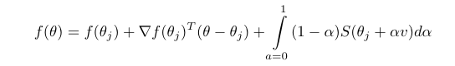
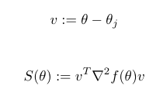
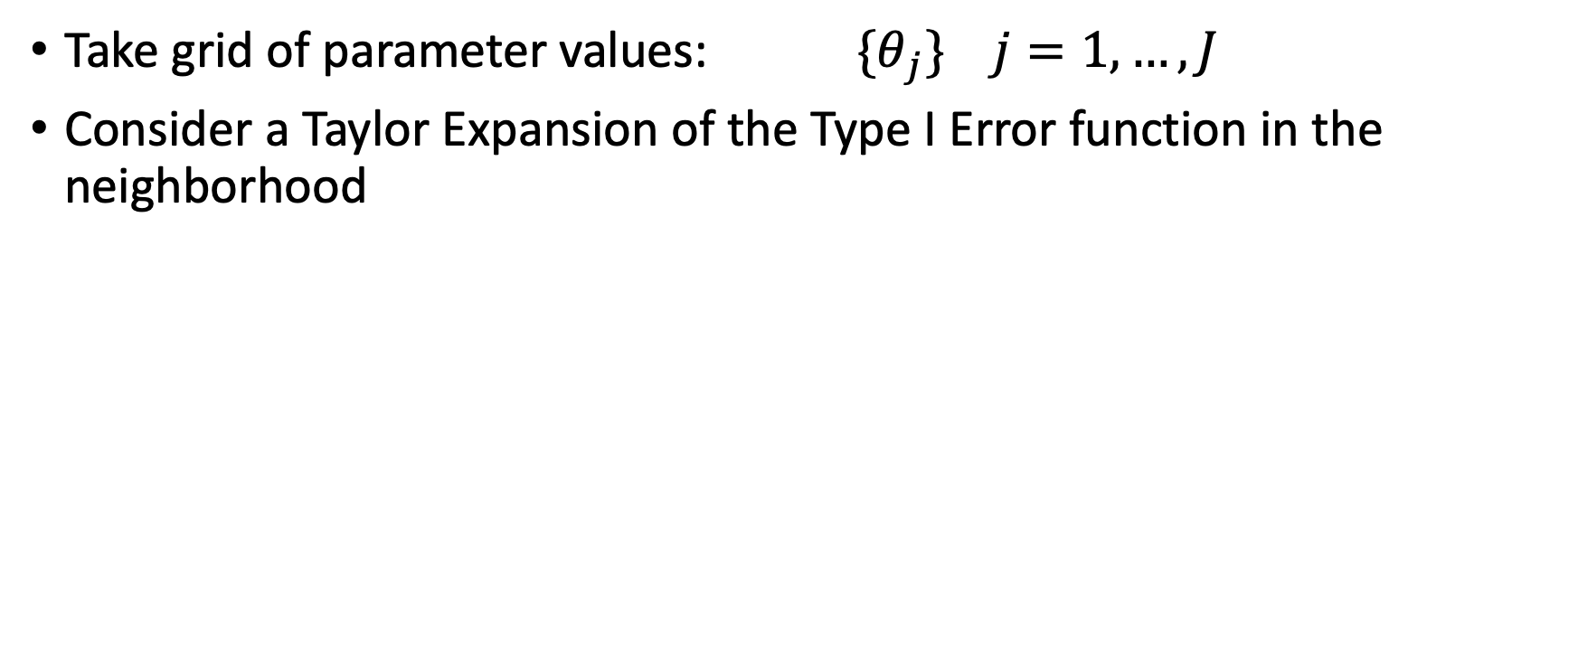
Underlying Idea: Taylor Expansion
Take grid of parameter values: ${\{θ}_{j}\}$ $j=1, …, J$
Consider a Taylor Expansion of the Type I Error function in the neighborhood
where
Notes:
This is the Taylor Expansion in Remainder Form

Slide 49
Monte Carlo on grid points
Can get estimates with Monte Carlo

Slide 50
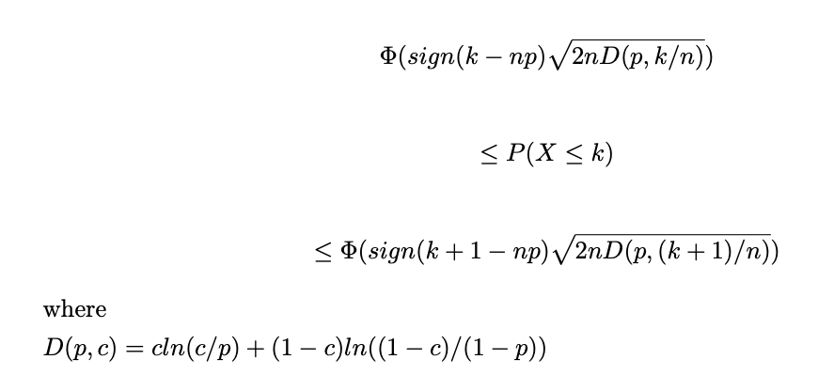
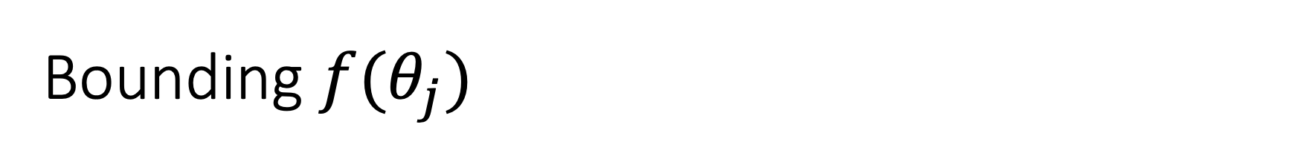
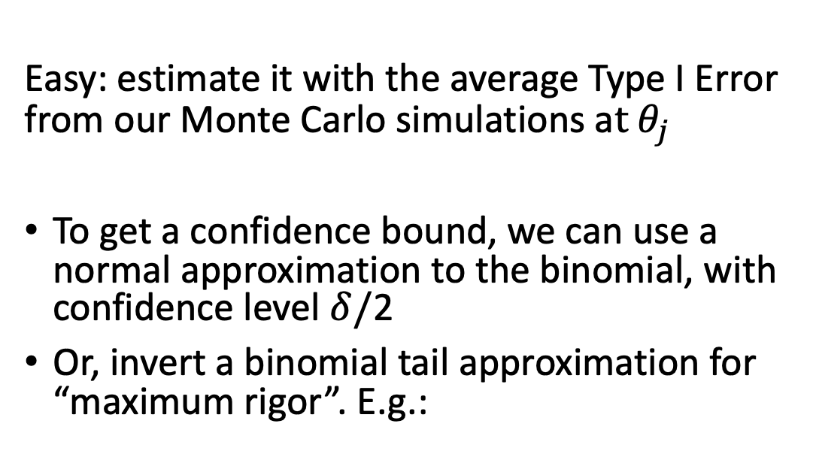
Bounding $f(θ_{j})$
Easy: estimate it with the average Type I Error from our Monte Carlo simulations a$t θ_{j}$
To get a confidence bound, we can use a normal approximation to the binomial, with confidence level $δ/$2
Or, invert a binomial tail approximation for “maximum rigor”. E.g.:

Slide 51

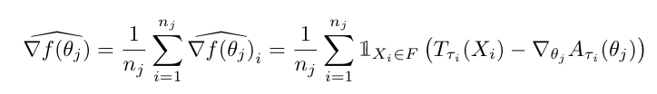
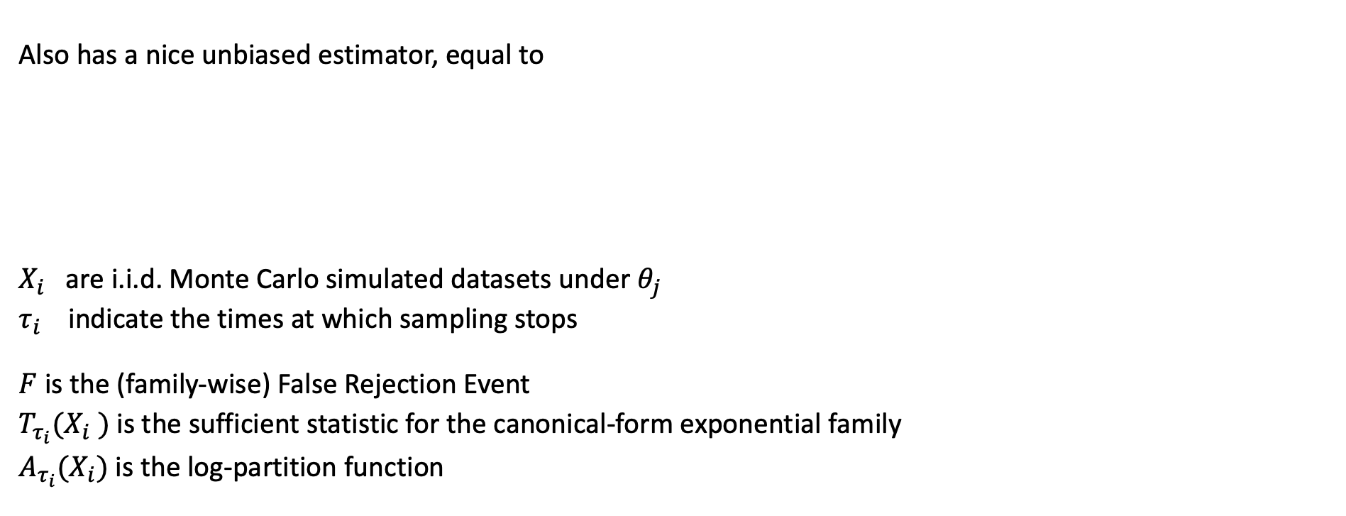
What about $∇f(θ_{j})$ ?
Also has a nice unbiased estimator, equal to
$X_{i}$ are i.i.d. Monte Carlo simulated datasets under $θ_{j}$
$τ_{i}$ indicate the times at which sampling stops
$F$ is the (family-wise) False Rejection Event
$T_{τ_{i}}(X_{i} )$ is the sufficient statistic for the canonical-form exponential family
$A_{τ_{i}}(X_{i})$ is the log-partition function

Slide 52
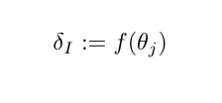
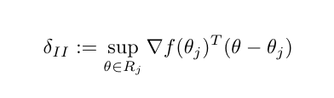
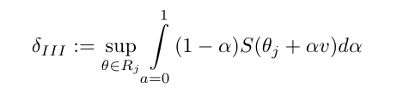
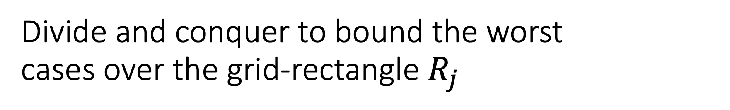
Divide and conquer to bound the worst cases over the grid-rectangle $R_{j}$

Slide 53
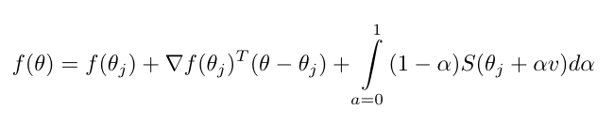
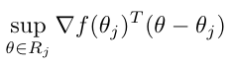
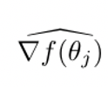
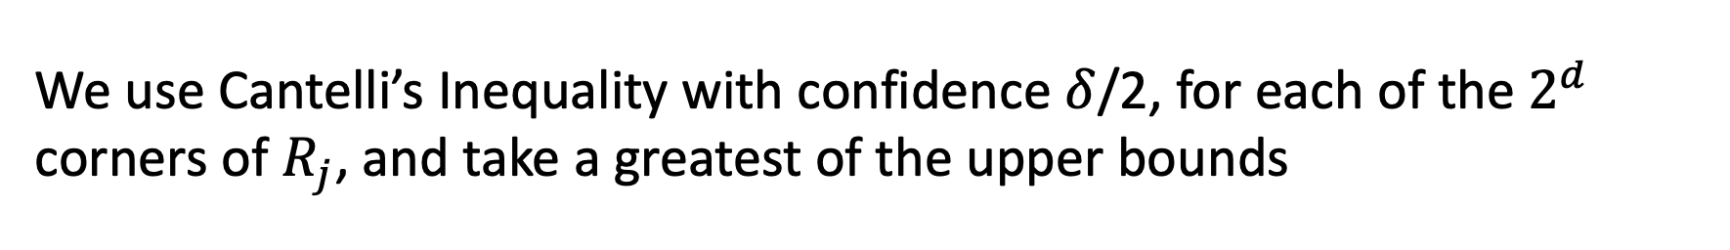
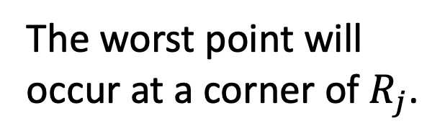
What about ?
The worst point will occur at a corner of $R_{j}$.
Martingales + Upper Bounds on Sample Sizes
Bound on the covariance matrix of
We use Cantelli’s Inequality with confidence $δ$/2, for each of the$2^{d}$ corners of $R_{j}$, and take a greatest of the upper bounds

Slide 54
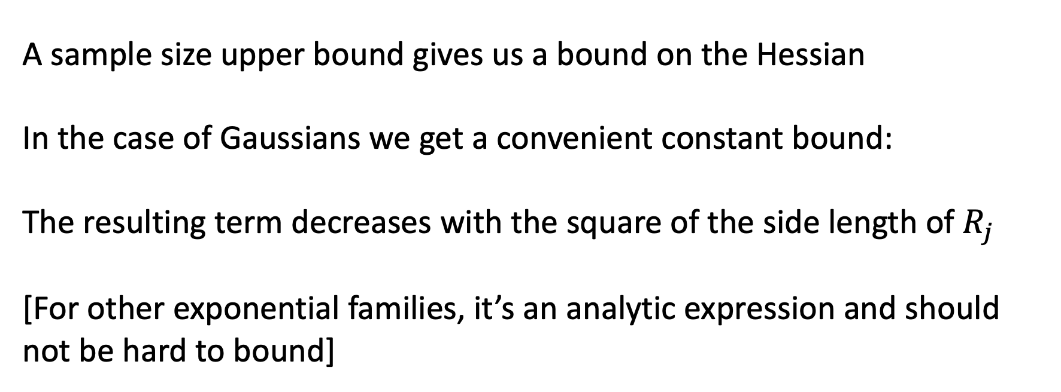
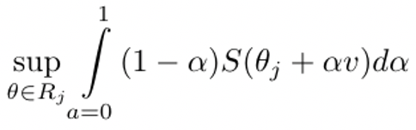
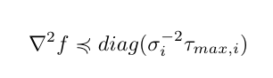
What about ?
A sample size upper bound gives us a bound on the Hessian In the case of Gaussians we get a convenient constant bound:
The resulting term decreases with the square of the side length of $R_{j}$
[For other exponential families, it’s an analytic expression and should not be hard to bound]
Notes:
The thesis proof requires a hard upper bound on the sample size. I believe you can get around that rigorously, by picking a sample size upper bound that you only exceed with very small probability.

Slide 55
Further questions?
End slides

